Slide 1
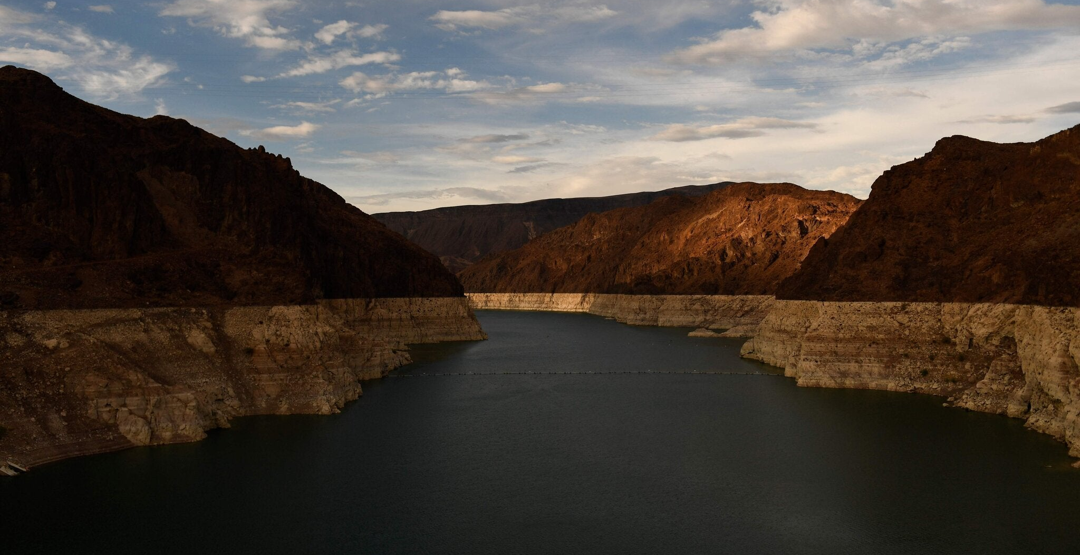
The Futures and Fortunes of
Drought Relief under Climate Change
Kyle Bocinsky
Director of Climate Extension
Montana Climate Office
University of Montana
Patrick T. Fallon/Agence France-Presse — Getty Images

Slide 2
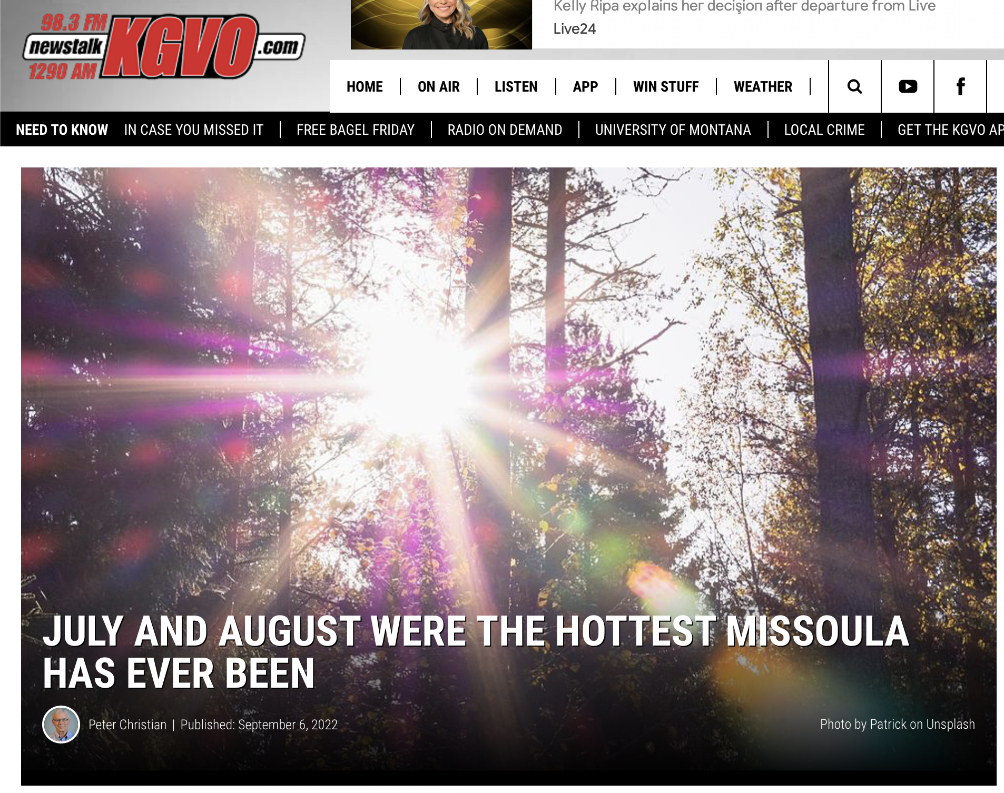
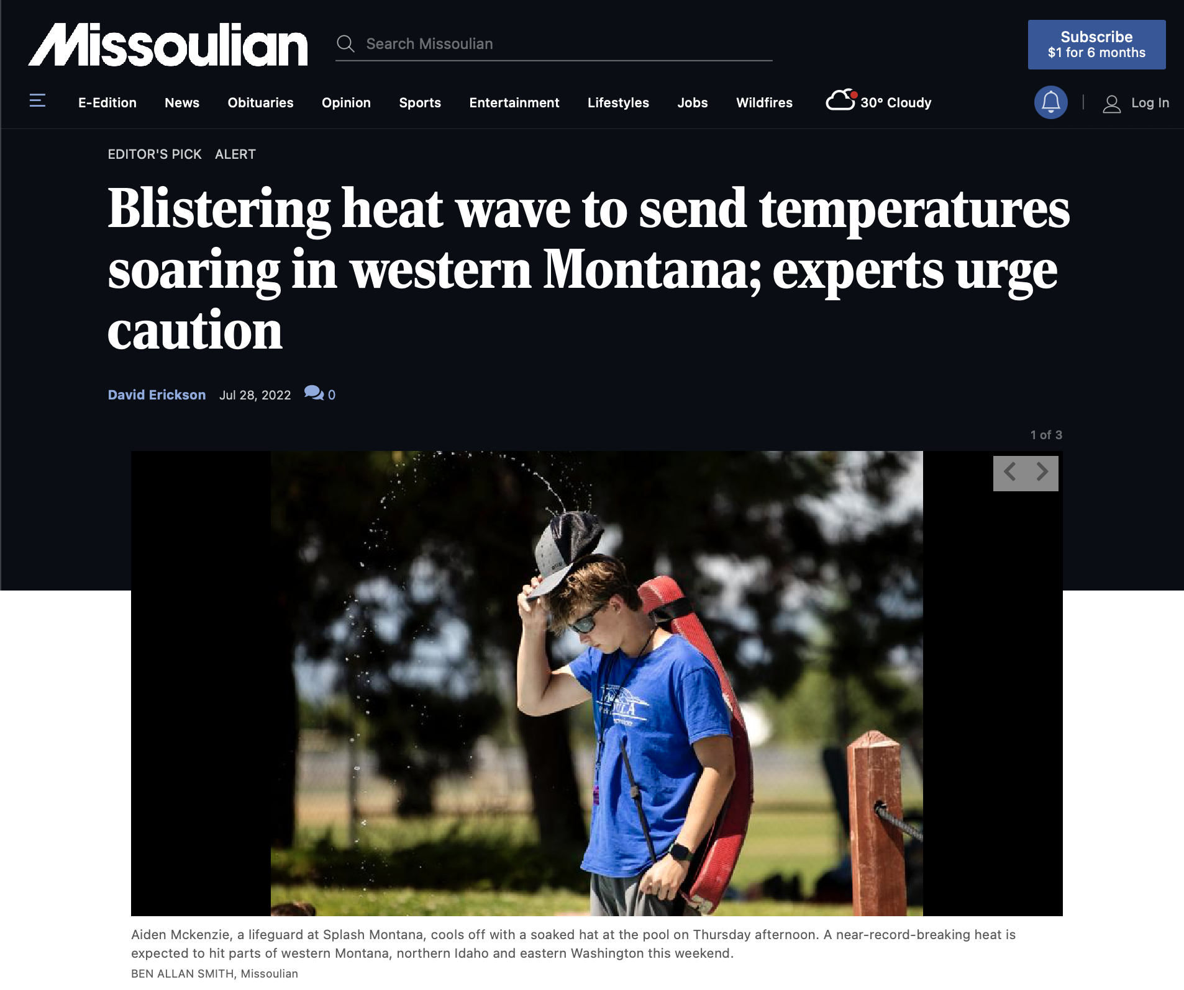
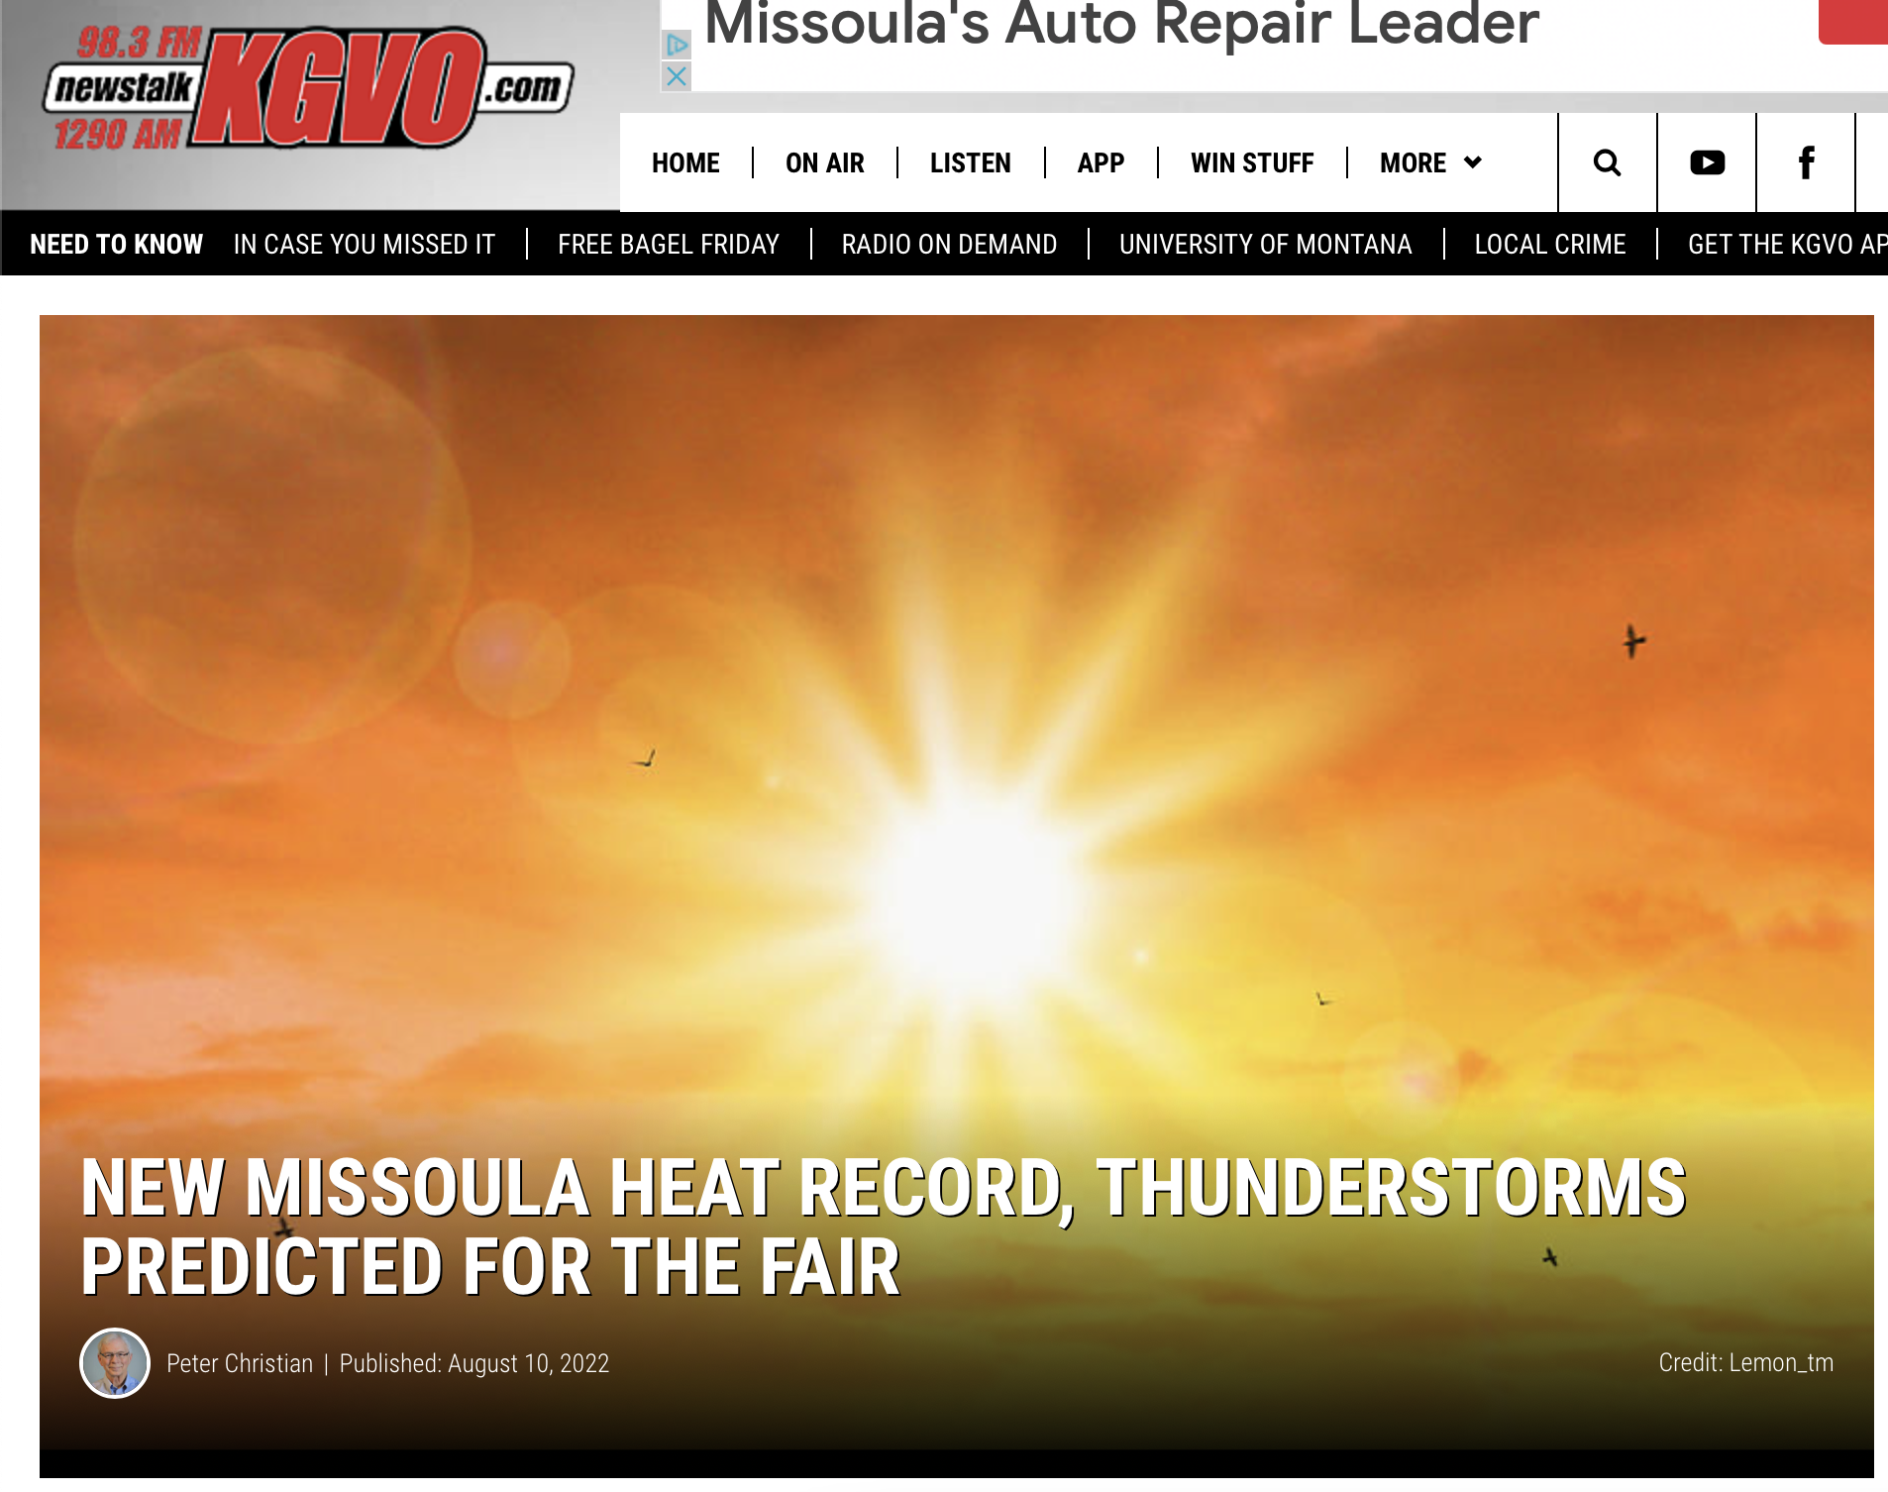
Patrick T. Fallon/Agence France-Presse — Getty Images

Slide 3
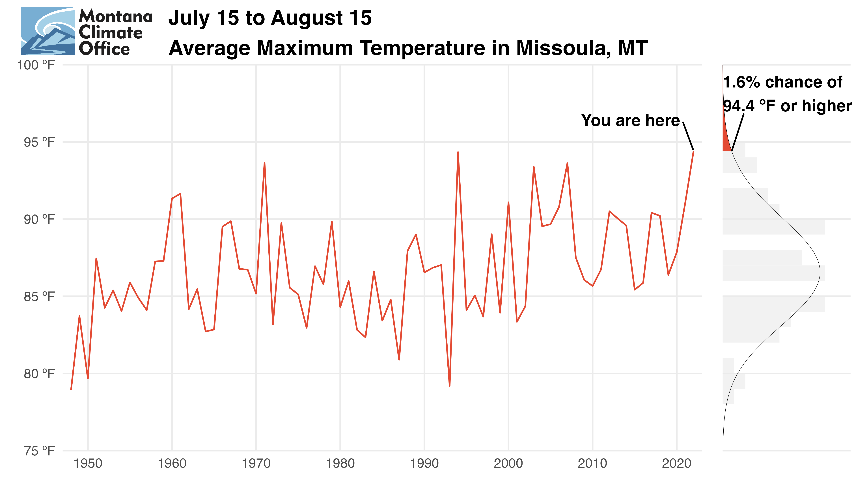

Slide 4
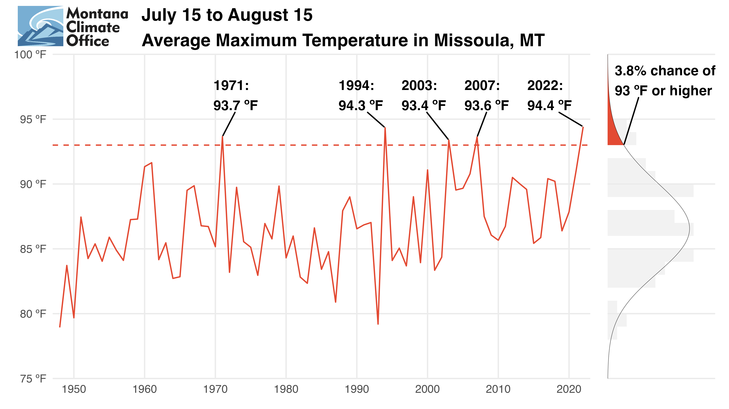

Slide 5
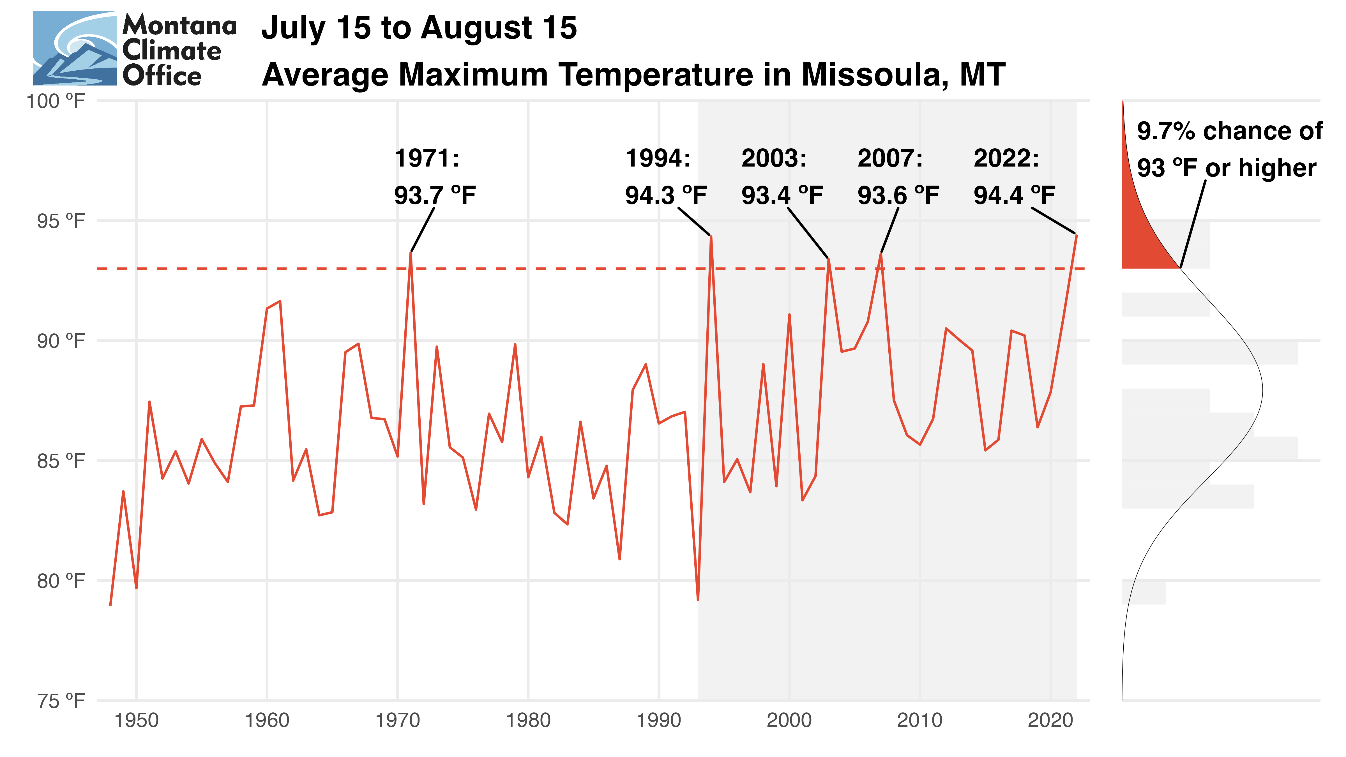

Slide 6
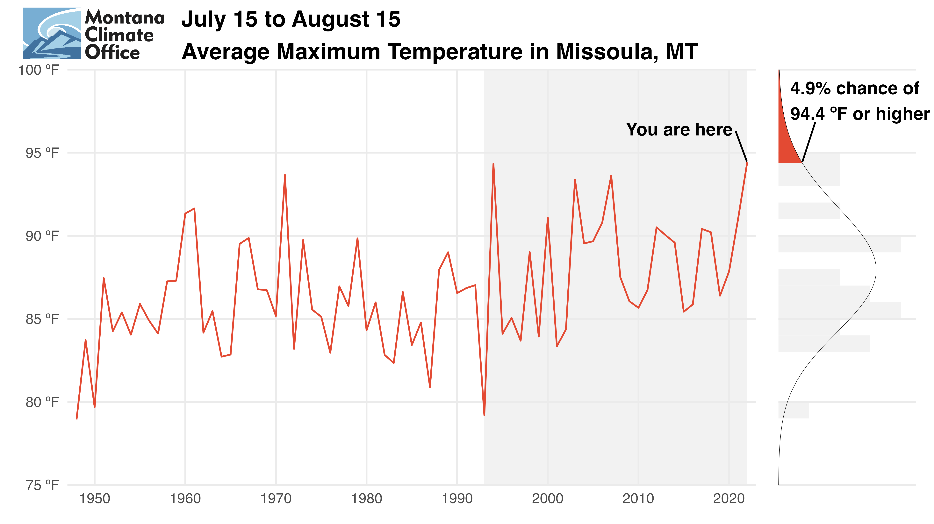

Slide 7
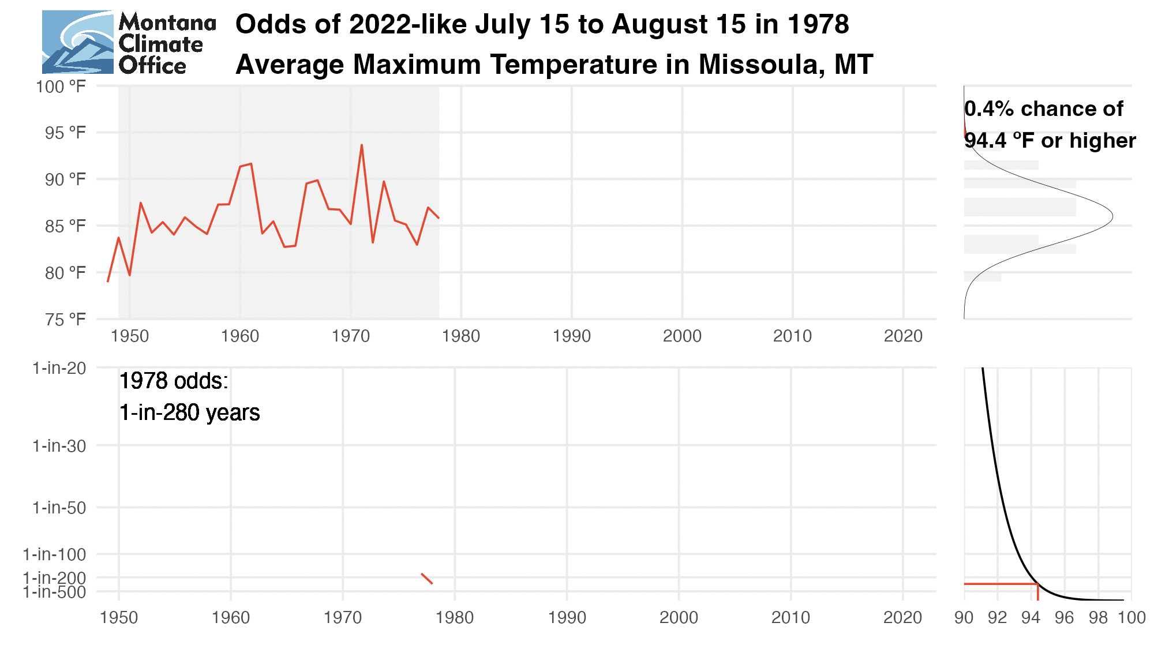
The cognitive dissonance of climate change
An event can be simultaneously
record-breaking and commonplace

Slide 8
Under stationary assumptions, drought severity is exaggerated in locations that are experiencing aridification and underrepresented in locations that are getting wetter.
This concept applies to other metrics commonly used in drought assessment.
Shifting to 30-year drought climatologies achieves the following goals:
Drought assessment better reflects present drought risk to affected communities;
Greater standardization across datasets with differing periods of record;
Better accounting for climate change into the future.
Patrick T. Fallon/Agence France-Presse — Getty Images

Slide 9
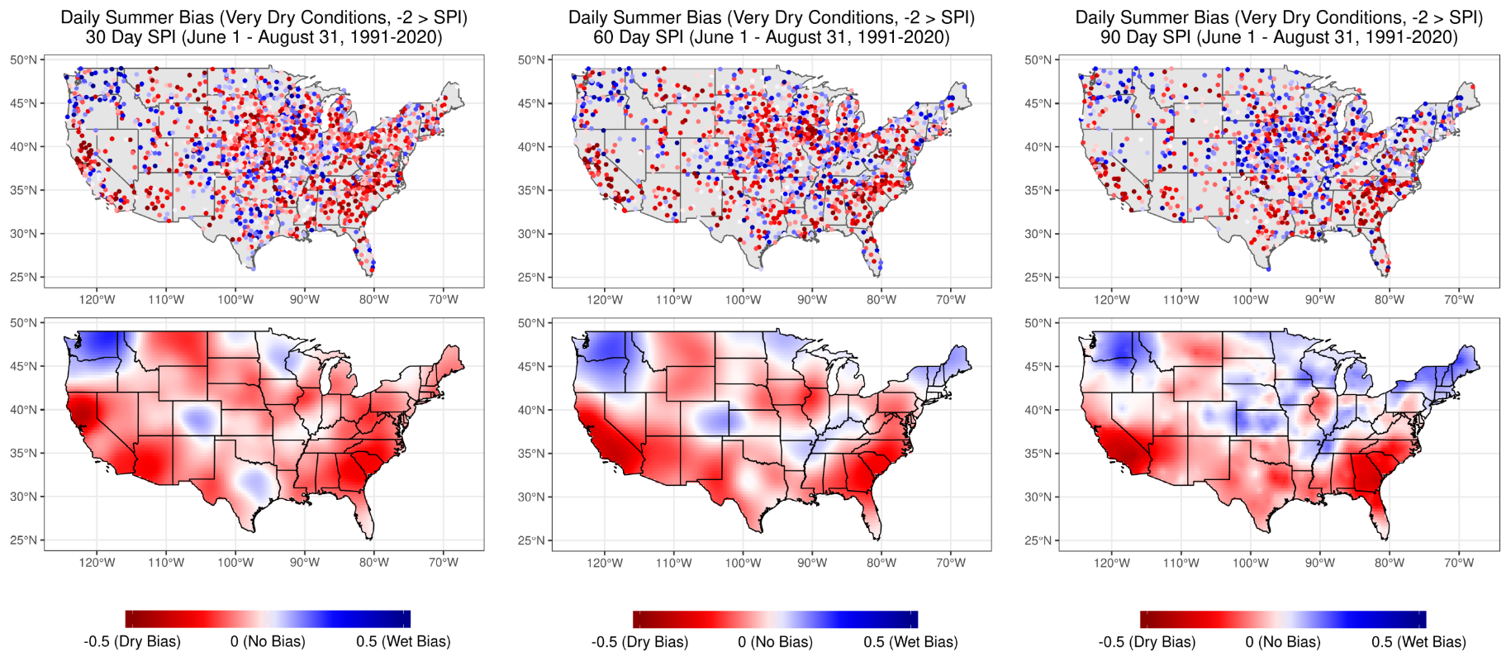
POR bias exceeds +/-1 class during severe drought

Slide 10
POR bias exceeds +/-1 class during severe drought

Slide 11
1.
USDM declarations for severe drought (>= D2) align with century-scale climatologies
Demonstrable bias against declaring
drought in places that are getting wetter
“Nearly automatic” disaster relief triggered by the USDM primarily benefits aridifying regions
Excess payments may be
undermining adaptation
Climate change scenarios suggest amplifying inequities in assistance
If the money is there to begin with…
2.
3.

Slide 12
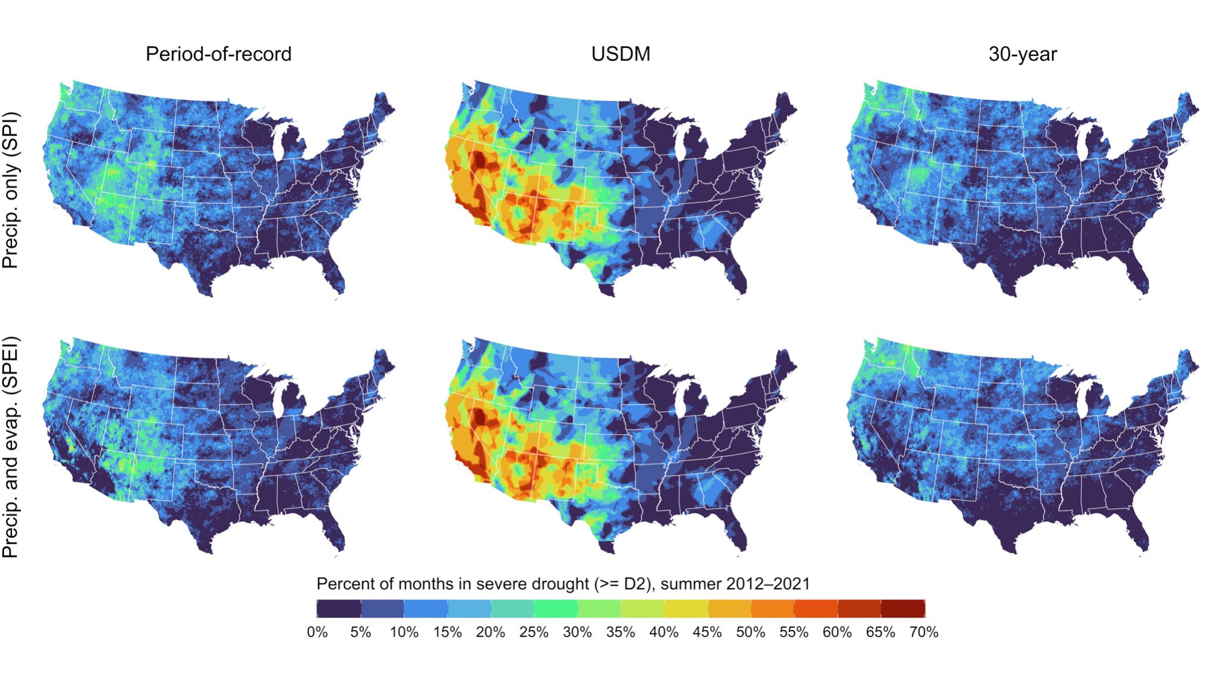
Summertime severe drought declarations
USDM declares severe drought more often than either reference period
Spatial patterns of POR (Southwest, southern Rockies) align with USDM
30-year reference period emphasizes drought conditions in Pacific NW

Slide 13
Provider | Base Data | Reference Period | Documentation
West Wide Drought Tracker (SPI/SPEI) | PRISM | Full POR (1895-present) | https://wrcc.dri.edu/wwdt/about.php
Climate Prediction Center (SPI) | CPC (Unified Precipitation Analysis) | Full POR (1950-present) | https://www.cpc.ncep.noaa.gov/products/Drought/Monitoring/spi.shtml
NCEI/NOAA NADM (SPI) | ? | Full POR (1951-Last Full Year) | https://www.ncei.noaa.gov/access/monitoring/nadm/indices/spi/div
Western Regional Climate Center - WRCC (SPI) | NOAA/NWS/CPC NOAA/NESDIS/NCDC | Full POR (1895-present) | https://wrcc.dri.edu/Monitoring/spi_products.php https://wrcc.dri.edu/cgi-bin/spiFmap.pl?spi01
SPEI Global Drought Monitor (SPEI) | NOAA NCEP CPC GHCN_CAMS / GPCC | 1950 - 2010 | https://spei.csic.es/map/maps.html#months=1#month=7#year=2022
High Plains Regional Climate Center - HRPCC (SPI / SPEI) | Station data | POR of each station (truncated at 1900) 1980 - present (SPEI) | Email documentation
PSL - NOAA (EDDI) | NLDAS-2 | 1979-present | https://psl.noaa.gov/eddi/

Slide 14
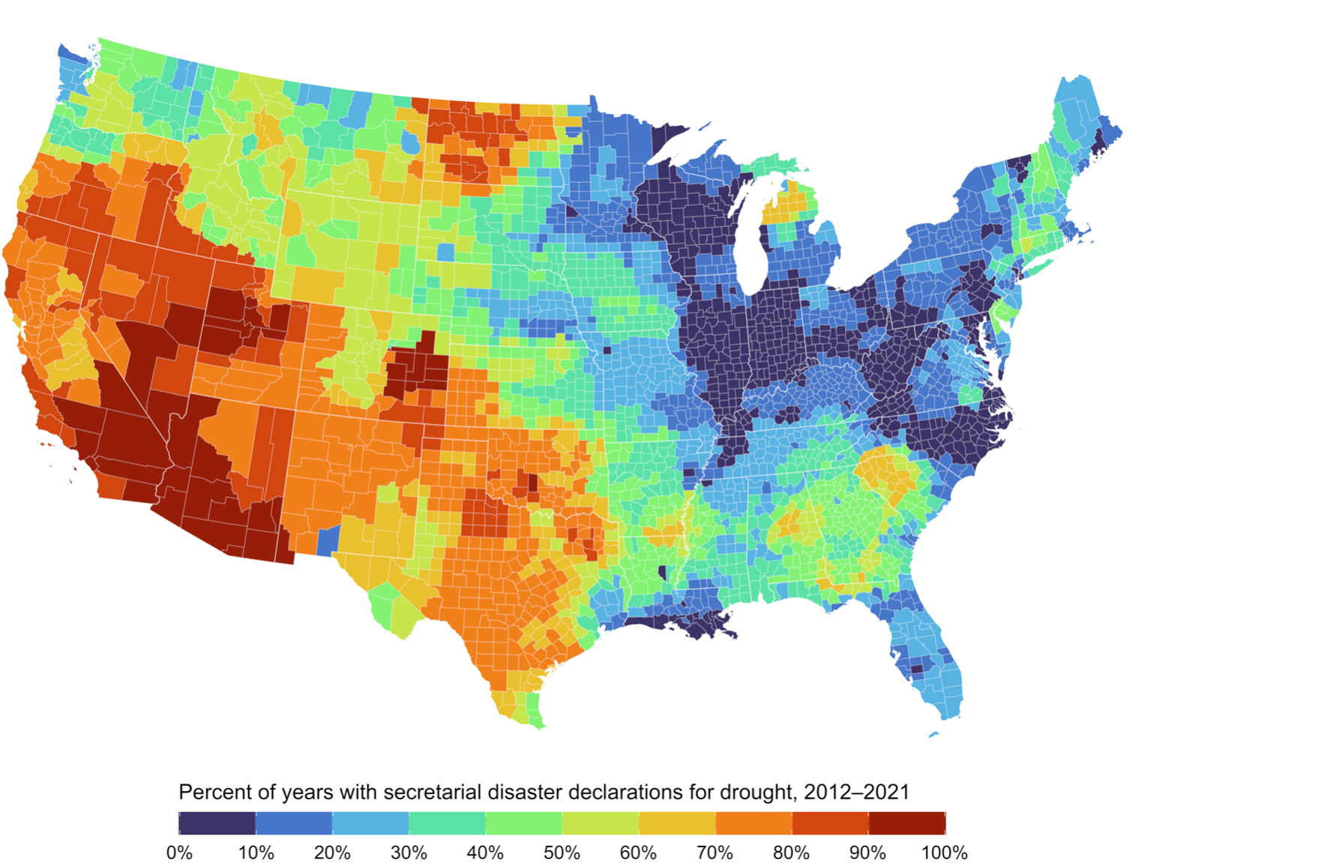
USDM triggers disaster declarations and relief
USDA Secretarial
Drought Disasters
“Fast Track” Secretarial disaster designations for severe drought provide for a nearly automatic designation when, during the growing season, any portion of a county meets the D2 (Severe Drought) drought intensity value for eight consecutive weeks or a higher drought intensity value for any length of time as reported in the U.S. Drought Monitor.
7 CFR § 759.5 - Secretarial disaster area determination and notification process

Slide 15
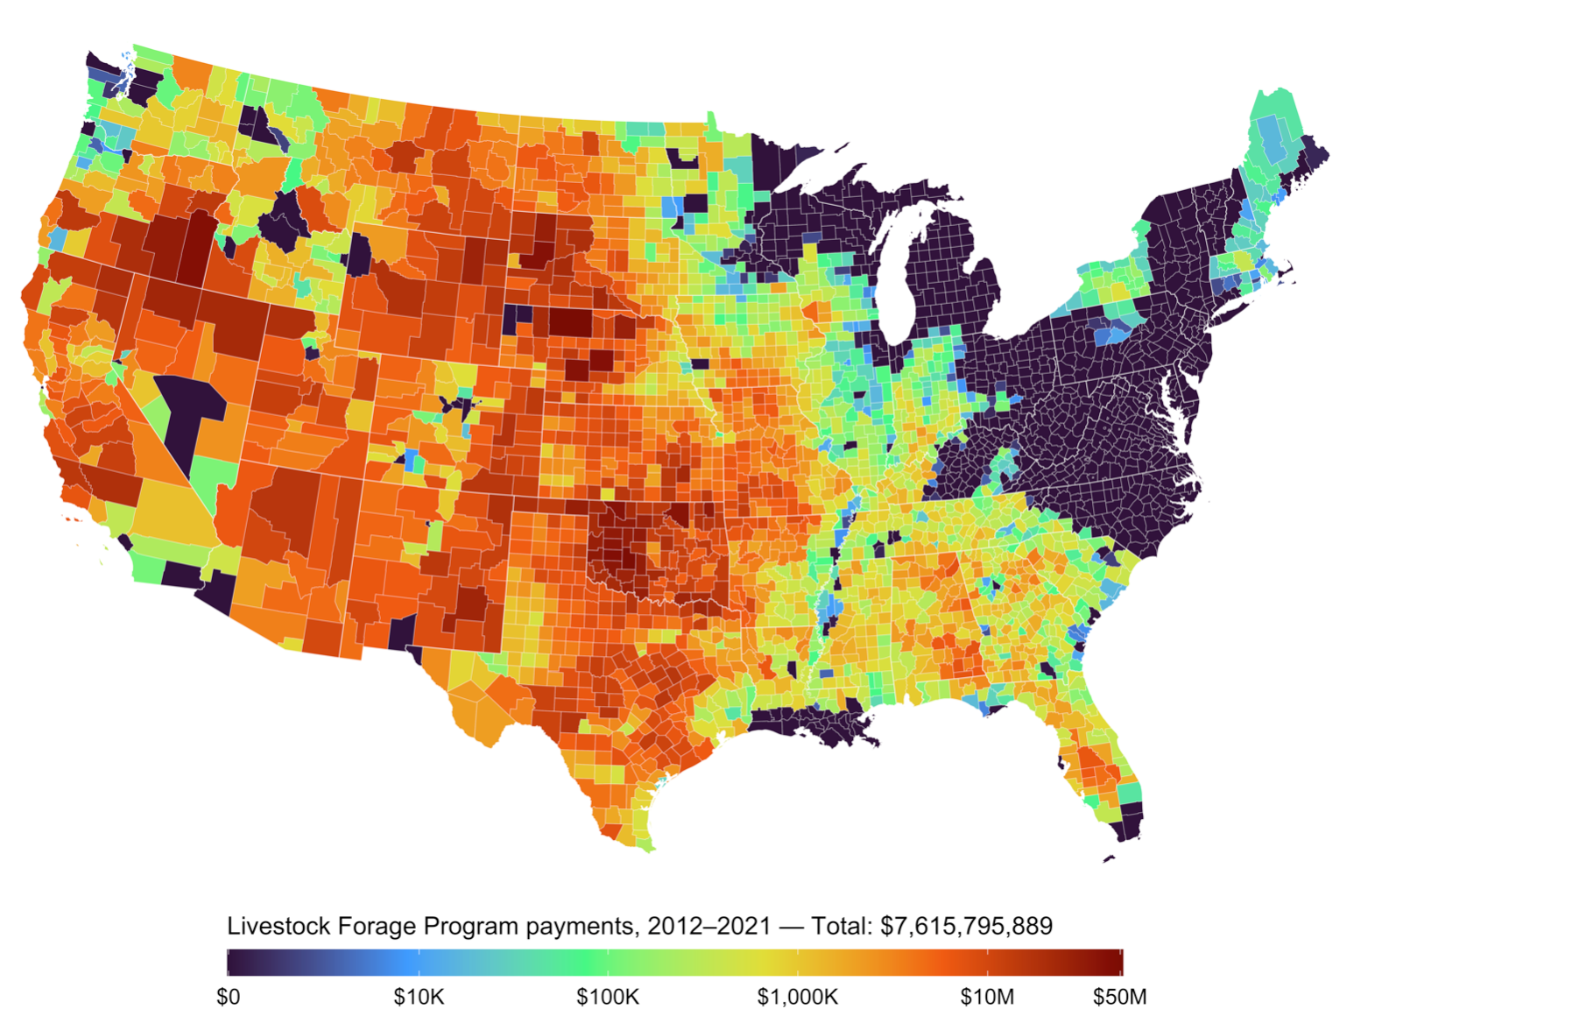
USDM triggers disaster declarations and relief
Livestock Forage Program
Eligibility Criteria
1 monthly payment:
D2 (severe drought) for at least eight consecutive weeks
3 monthly payments:
D3 (extreme drought) at any time
4 monthly payments:
D3 (extreme drought) for at least four consecutive weeks or D4 (exceptional drought) intensity at any time
5 monthly payments:
D4 (exceptional drought) for any four weeks
7 CFR § 1416.205 - Eligible grazing losses

Slide 16
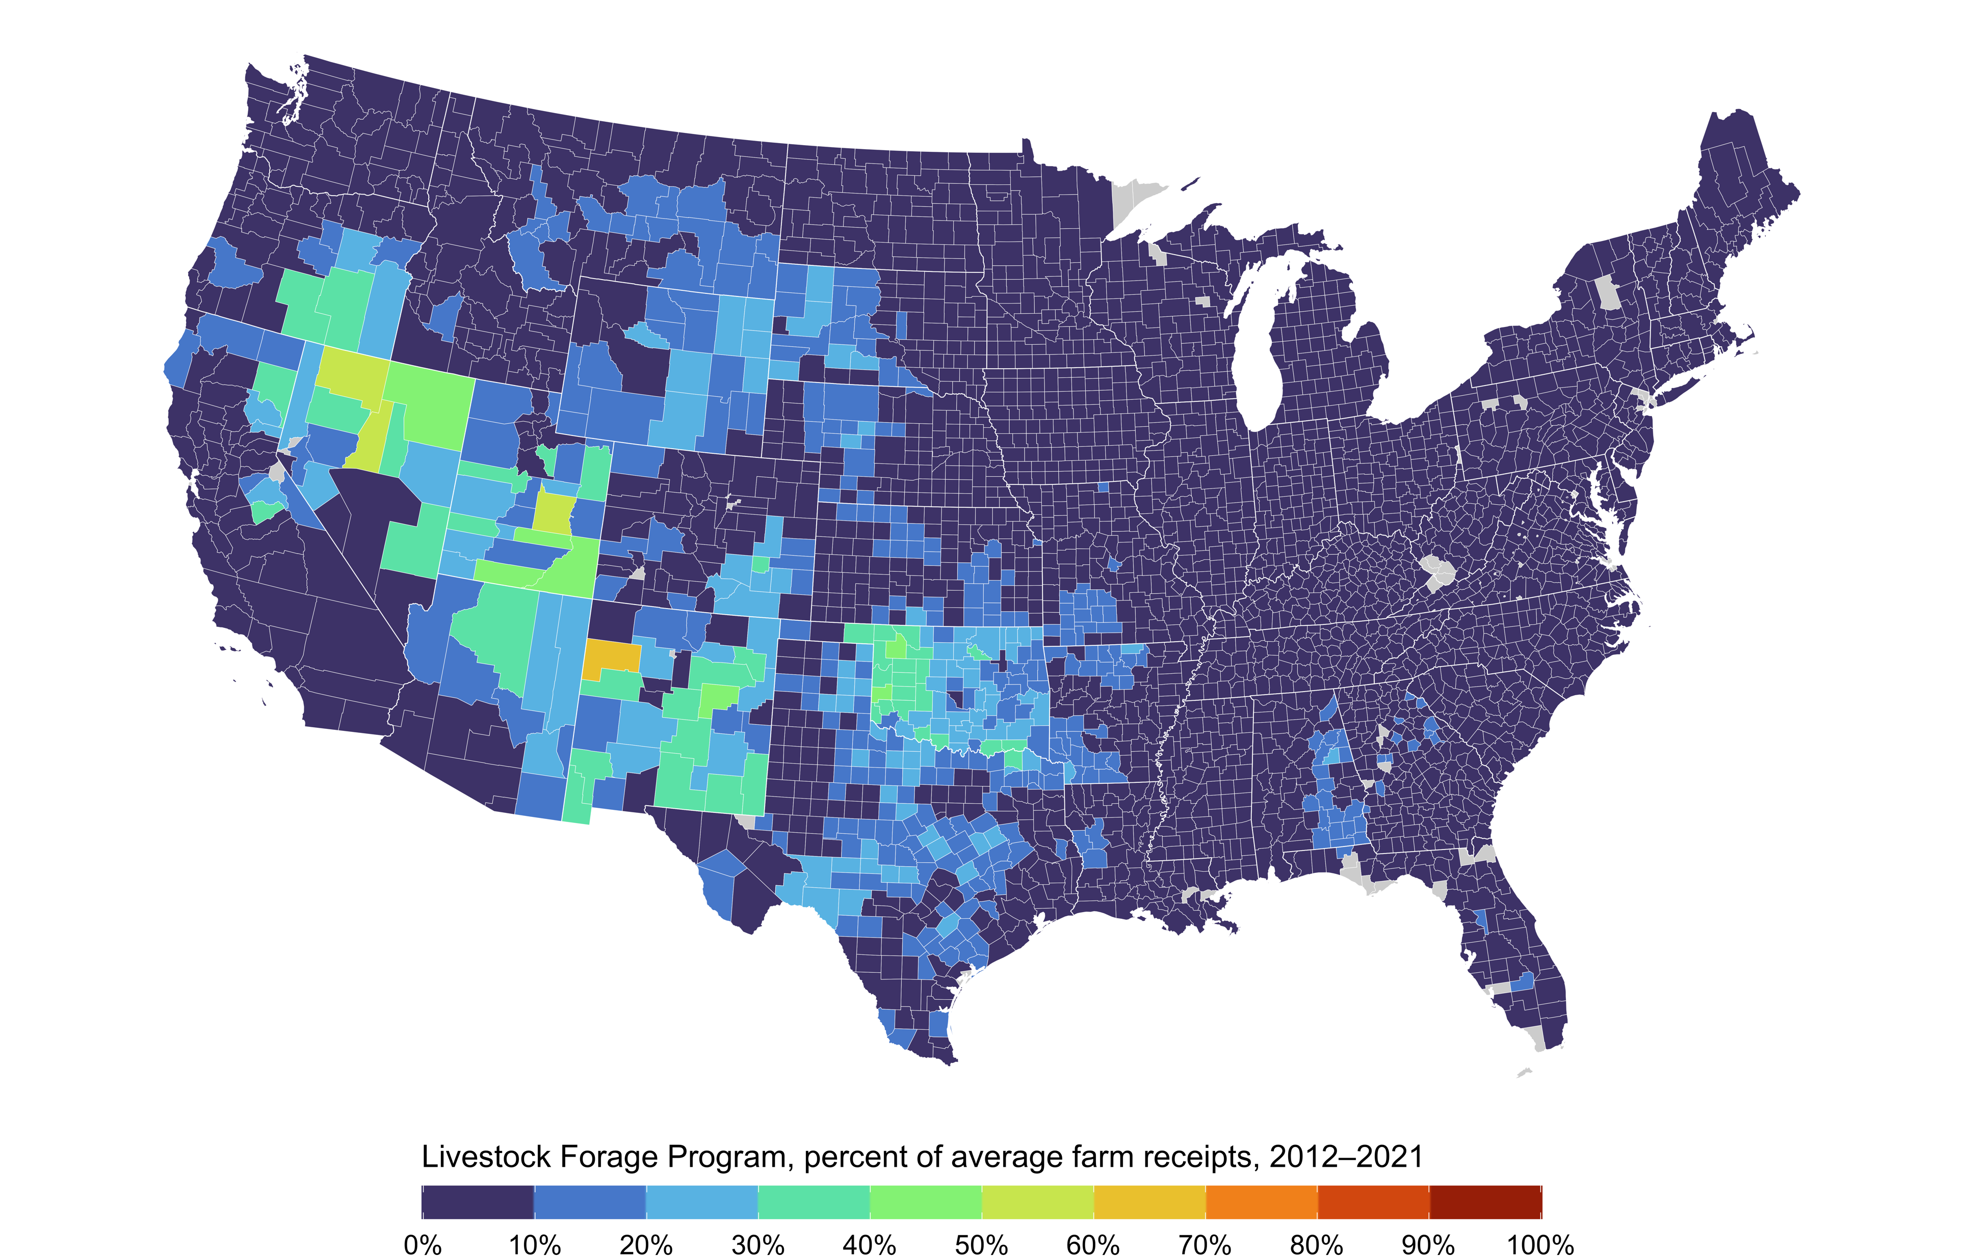
USDM triggers disaster declarations and relief
Livestock Forage Program
Eligibility Criteria
1 monthly payment:
D2 (severe drought) for at least eight consecutive weeks
3 monthly payments:
D3 (extreme drought) at any time
4 monthly payments:
D3 (extreme drought) for at least four consecutive weeks or D4 (exceptional drought) intensity at any time
5 monthly payments:
D4 (exceptional drought) for any four weeks
7 CFR § 1416.205 - Eligible grazing losses

Slide 17
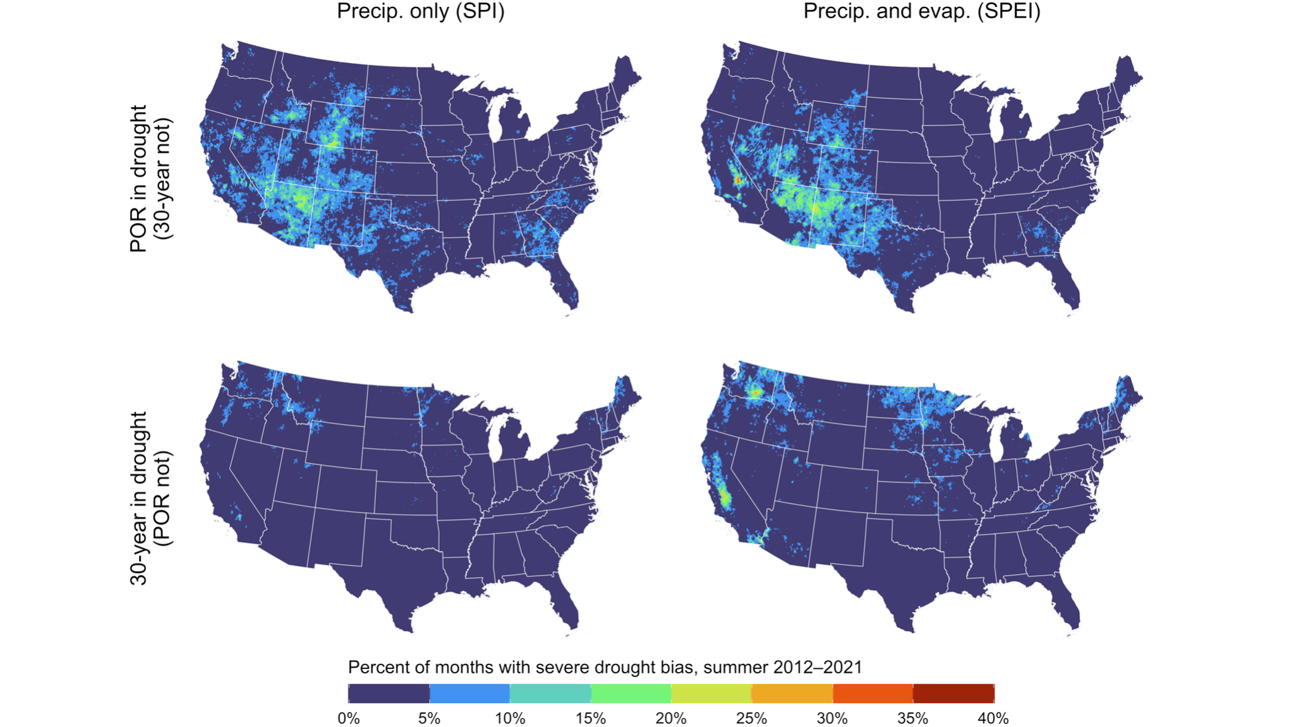
Drought bias affects disaster declarations and relief
Regions where aridification is occurring and climate adaptation needed most.
Climate patterns are shifting here too, leading to an under-assessment of drought conditions.

Slide 18
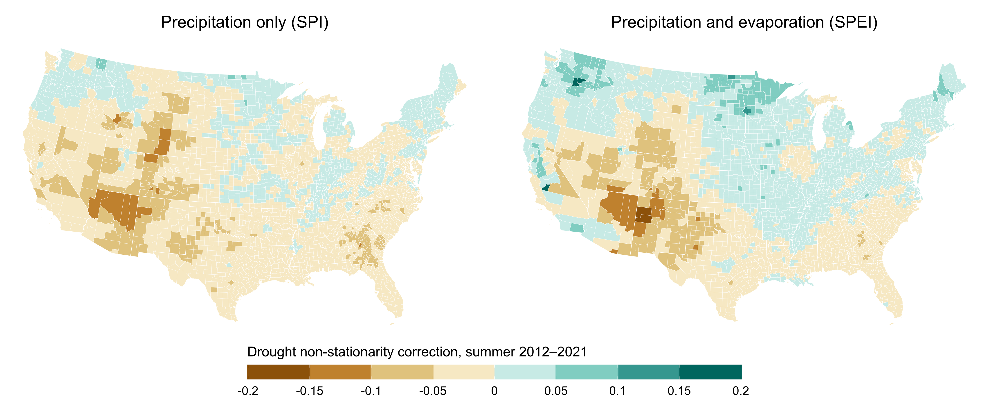
Drought bias affects disaster declarations and relief

Slide 19
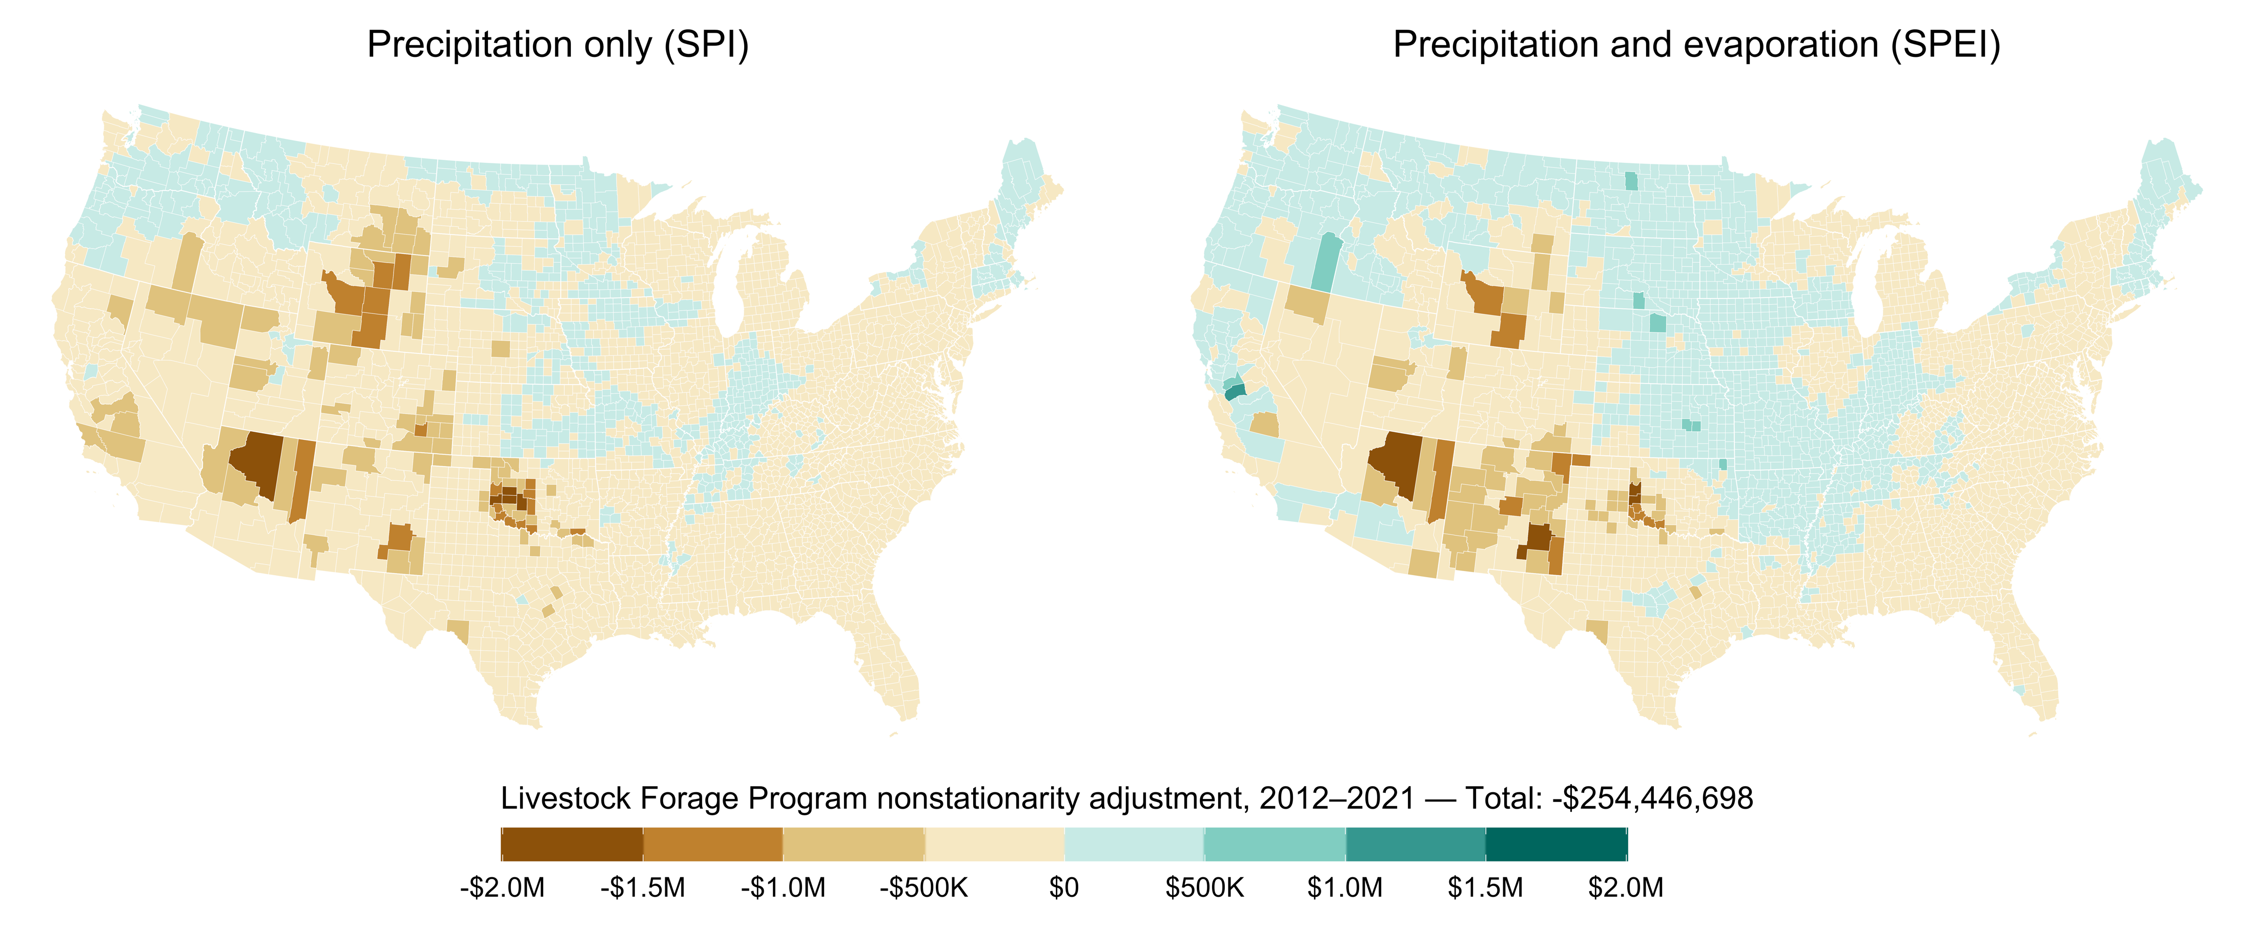
Drought bias affects disaster declarations and relief
Under a 30-year reference period, drought relief would have been distributed differently, and would have been substantially less costly.

Slide 20
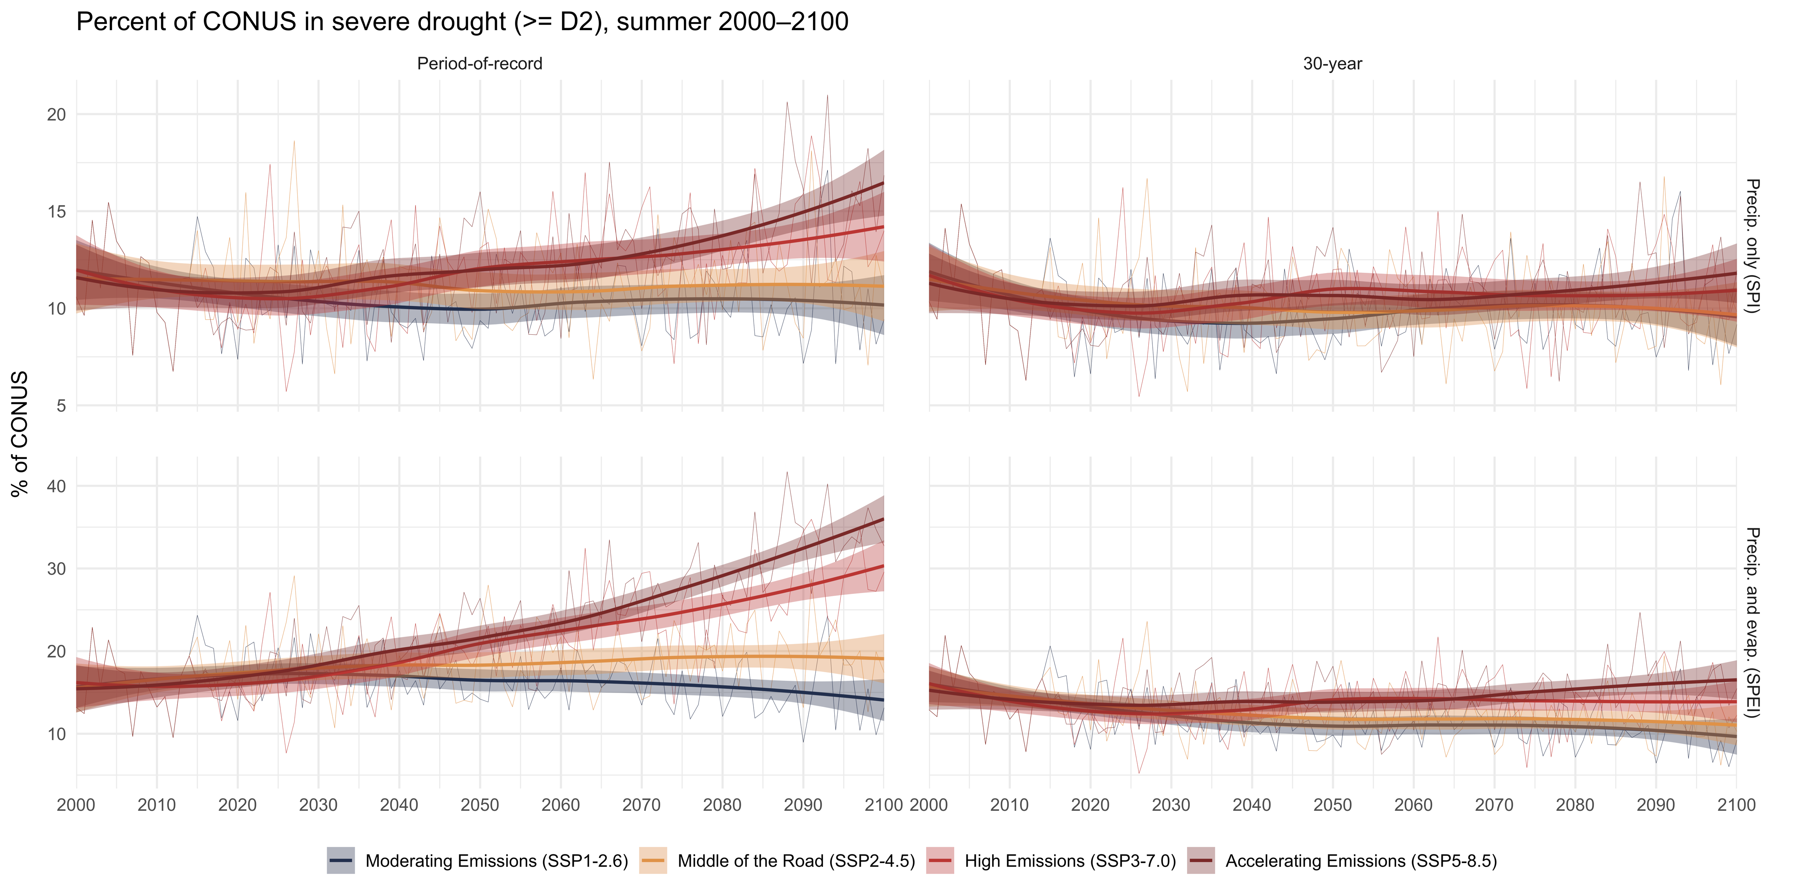
POR-based drought relief is unsustainable

Slide 21
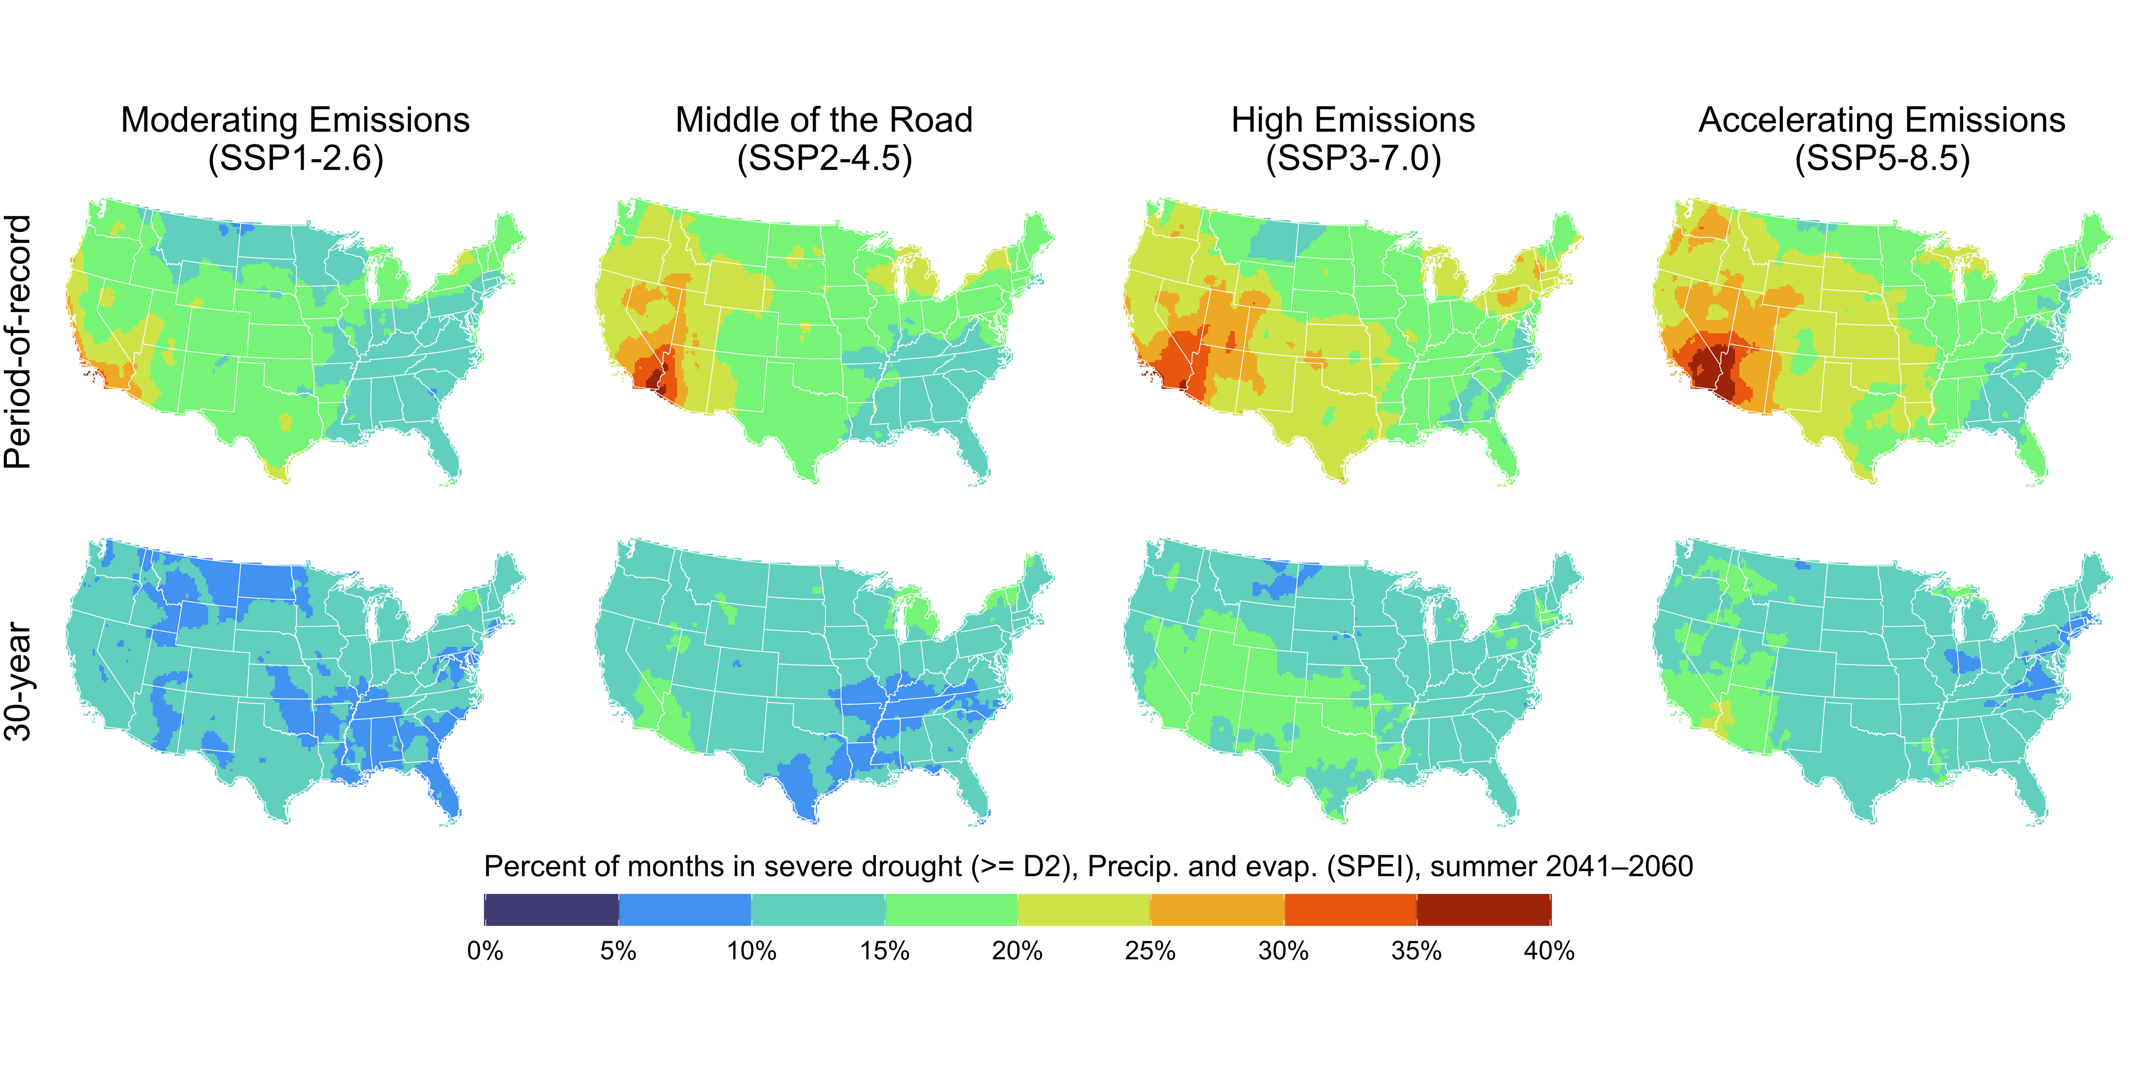
POR-based drought relief is unsustainable

Slide 22
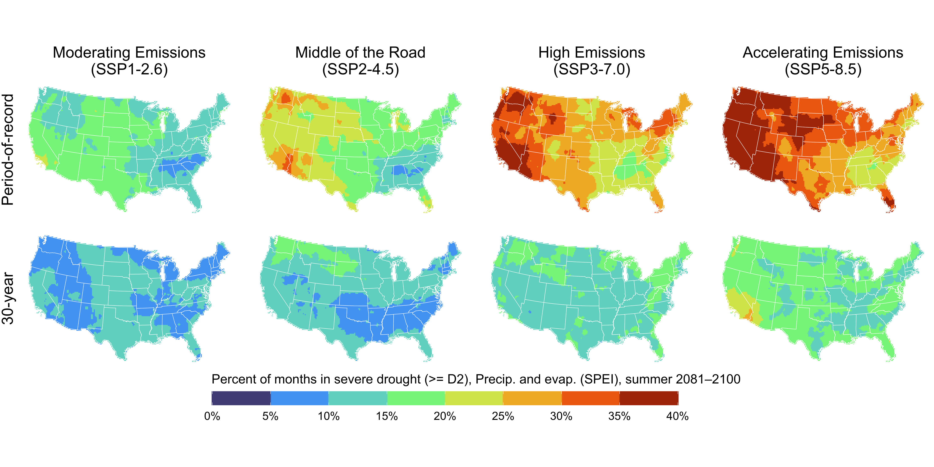
POR-based drought relief is unsustainable
POR-based drought declarations likely to enter a state of “perpetual drought” by the end of the century.

Slide 23
Recommendations for drought monitoring
1.
Begin the transition to standard, regularly updated reference periods (climatologies).
Develop sector-specific drought assessments that align with adaptive capacity.
Engage more fully with climate projections in order to inform drought adaptation efforts.
2.
3.
Notes:
Keep the money in the federal budget (Enhances equality)
Redistribute to regions with wet bias? (Enhances equity)
Reinvest in climate adaptation (Enhances resilience)

Slide 24
Recommendations for policymakers
1.
Ensure that [drought] relief programs are responding to contemporary risk.
Support drought monitoring as a tool for both risk assessment and climate adaptation.
Target adaptation in those places and sectors that are experiencing the greatest change.
2.
3.
Notes:
Keep the money in the federal budget (Enhances equality)
Redistribute to regions with wet bias? (Enhances equity)
Reinvest in climate adaptation (Enhances resilience)

Slide 25



Montana Climate Office
climate.umt.edu
Kyle Bocinsky: kyle.bocinsky@umt.edu
Zachary Hoylman: zachary.hoylman@umt.edu
Colin Brust: colin.brust@umt.edu
Kelsey Jencso: kelsey.jencso@umt.edu
@mt_climate

